Slide 1
Best Practices
SE499: Software Design & Development Project

Slide 2
Define a clear and concise project scope statement
Clearly define the project's goals, deliverables, and timelines.
Identify stakeholders, their needs, and their roles in the project.
Establish a process for scope changes and ensure that all stakeholders are aware of it.

Slide 3
Understanding the Real-World Impact
Our project addresses a critical issue in the [industry/field]
The problem we're solving affects [number] of people/businesses/organizations
Our solution has the potential to improve [aspect of society/environment/economy]

Slide 4
Connecting Our Project to Real-World Challenges
"Our project addresses a specific challenge in the [industry/field]
This challenge is a major concern for [stakeholders/businesses/organizations]
Our solution could potentially disrupt/improve the way [industry/field] operates
Our project aligns with the goals of [related initiatives/policies/regulations]

Slide 5
Potential Impact
Our solution has the potential to [positive impact on society/environment/economy]
This impact could be felt by [number] of people/businesses/organizations
Our project could contribute to [larger social/environmental/economic goal]
The potential benefits of our project are [specific benefits, e.g. cost savings, increased efficiency, improved health outcomes]

Slide 6
What Sets Our Project Apart
"Our project is unique because it [briefly describe the project's unique features or approach]
This approach/feature set us apart from other projects in the industry
Our project's uniqueness provides a competitive advantage in the market

Slide 7
The Value We Bring
Our project offers [describe the specific benefits or value that the project provides]
These benefits/value are not currently available in the market
Our project's added value sets us apart from the competition

Slide 8
Our Competitive Edge
Our project's unique approach/features give us a competitive advantage in the market
Our project offers [describe the specific benefits or value that the project provides]
This sets us apart from the competition and provides a strong selling point

Slide 9
Capitalizing on a Growing Market
The market for [specific industry/service] is growing rapidly
Our project is well-positioned to capitalize on this growth
Our unique approach/features make us an attractive option for customers

Slide 10
Use design patterns and principles
Use design patterns to solve common software design problems.
Design Patterns: A Solution to Common Software Design Problems
Examples of design patterns (e.g. Singleton, Factory, Observer)
Benefits of using design patterns (e.g. improves code maintainability, scalability, and extensibility)

Slide 11
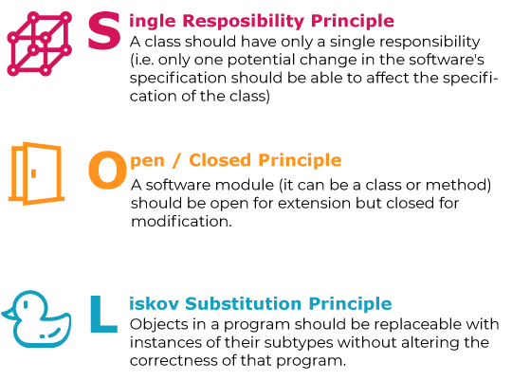
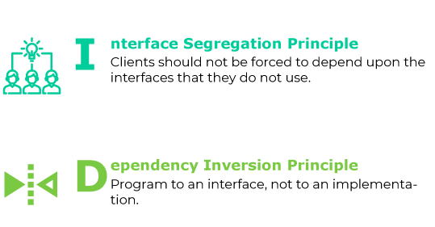
SOLID Principles
Apply principles such as SOLID (Single Responsibility, Open/Closed, Liskov Substitution, Interface Segregation, and Dependency Inversion) to ensure that code is maintainable, scalable, and extensible.

Slide 12
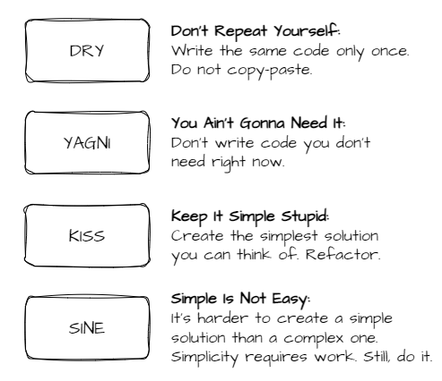
DRY (Don't Repeat Yourself)
DRY is a principle that emphasizes the importance of avoiding duplication in software systems.
It encourages developers to create reusable code and to avoid repeating the same code or functionality in multiple places.
Duplication can lead to maintenance nightmares, bugs, and inconsistencies.

Slide 13
DRY (Don't Repeat Yourself)
DRY can be applied in various ways, such as:
Functional programming: Write functions that perform a single task and can be reused in different parts of the codebase.
Modular design: Break down the codebase into smaller, independent modules that can be reused and combined in different ways.
Object-oriented programming: Use inheritance and polymorphism to create reusable classes and objects.
Utility classes: Create classes or modules that provide a set of related functions or utilities that can be used across the codebase.

Slide 14
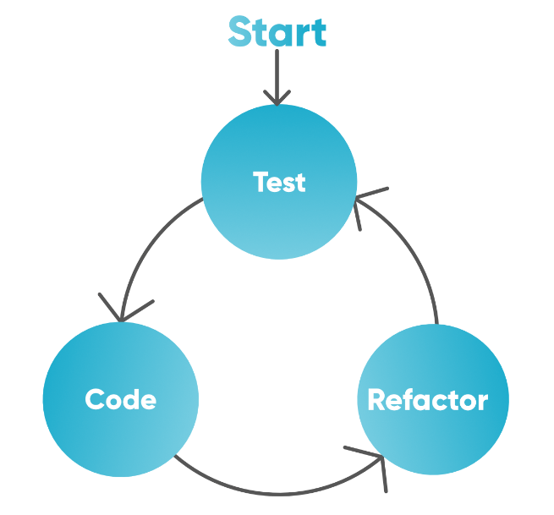
Write clean, modular, and maintainable code
Use modular design to break down code into smaller, independent components.
Write clean, readable, and maintainable code that adheres to coding standards and best practices.
Use version control systems to track changes and collaborate with team members.

Slide 15
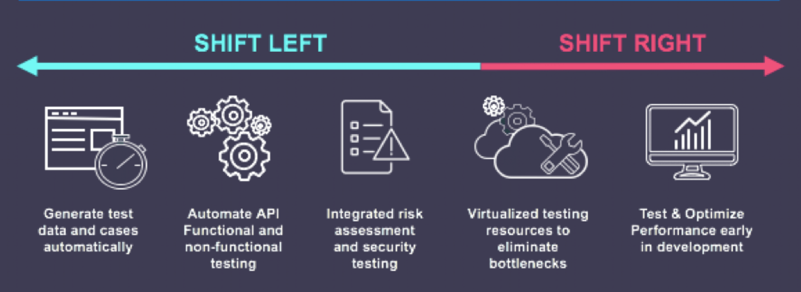
Test early and often
Develop a comprehensive testing strategy that includes unit, integration, system, and acceptance testing.
Use automated testing tools to ensure that tests are run repeatedly and consistently.
Use testing frameworks to write and run tests efficiently.

Slide 16
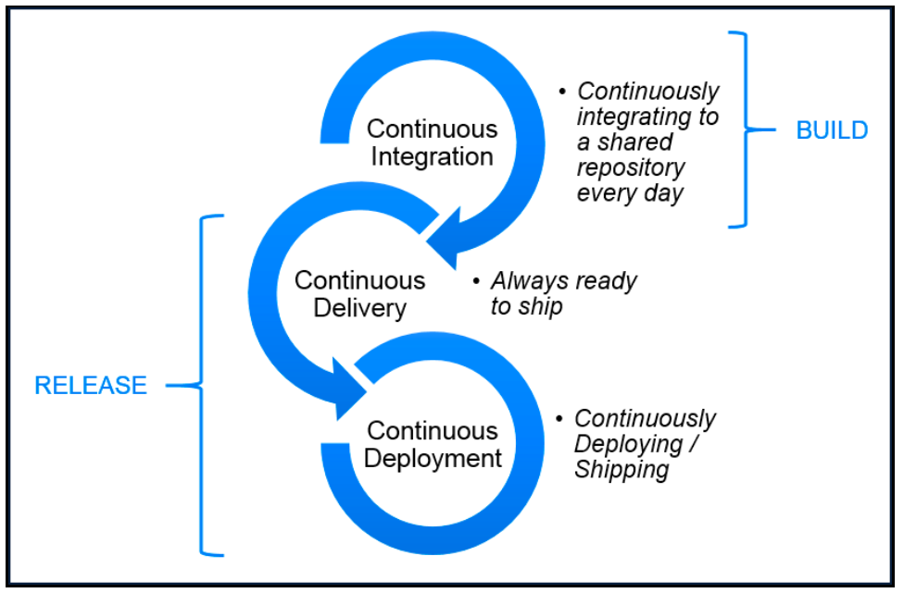
Use continuous integration and delivery
Use a CI/CD pipeline to automate the build, test, and deployment process.
Ensure that code changes are automatically built, tested, and deployed to production.
Use continuous monitoring and feedback to improve the quality and reliability of the software.

Slide 17
Document the project
Create comprehensive documentation that includes project scope, requirements, design, testing, and deployment.
Ensure that documentation is up-to-date and accessible to all stakeholders

Slide 18
The Importance of Documentation
Why documentation matters and how it can help your project succeed
Ensures that all stakeholders are on the same page
Provides a reference for future development and maintenance
Helps to identify and mitigate risks
Supports communication and collaboration among team members
Facilitates knowledge transfer and training

Slide 19
Best Practices for Documentation
Use simple language and avoid technical jargon
Organize documentation into clear and logical sections
Use headings, subheadings, and bullet points to make information easy to scan
Include examples and diagrams to illustrate complex concepts
Use active voice and avoid passive voice
Keep documentation up-to-date and review regularly
Use version control to track changes and collaborate with team members

Slide 20
Documentation
Documentation is an essential part of software development projects
Clear, concise, and comprehensive documentation helps to ensure project success
Following best practices for documentation can improve communication, collaboration, and productivity
Investing time and effort in documentation pays off in the long run
Remember, documentation is not just a requirement, it's an opportunity to create a better project.

Slide 21
Use security best practices
Use security best practices such as secure coding practices, secure communication protocols, and secure data storage.
Ensure that all sensitive data is encrypted and access is restricted to authorized personnel.

Slide 22
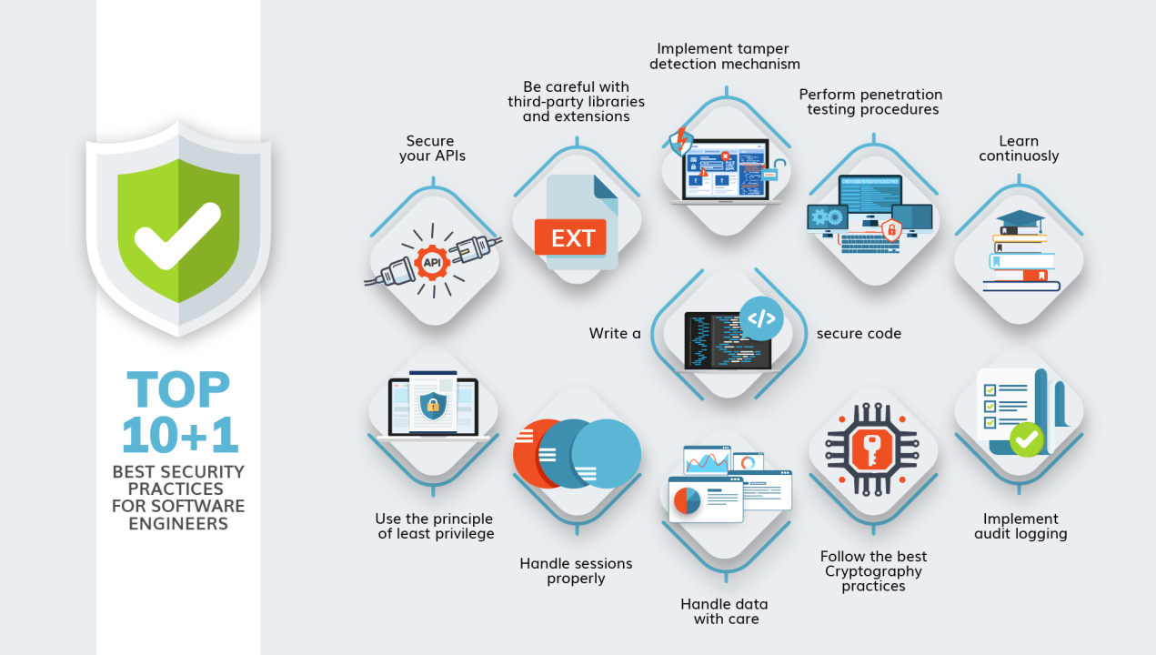

Slide 23
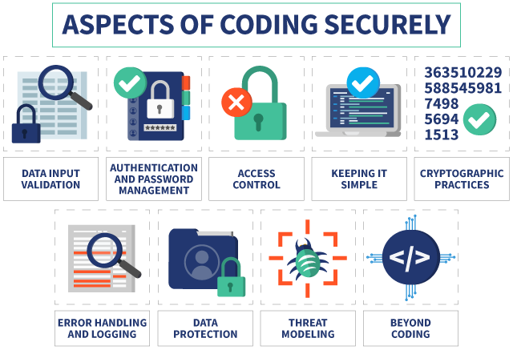
Coding Securely

